Slide 1
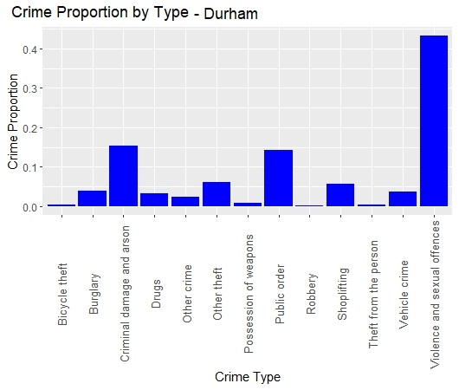
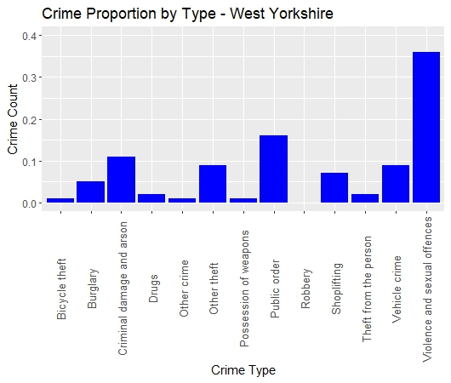
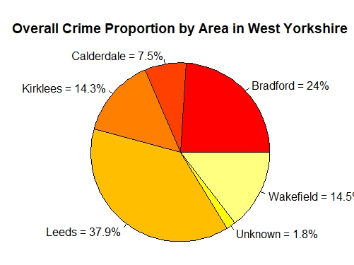
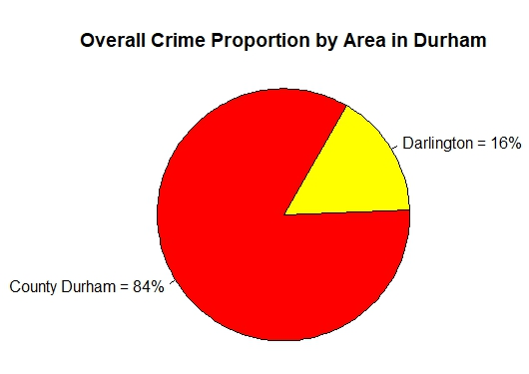
Insights:
The column charts on the left compare the proportions of crime types in the areas of West Yorkshire and Durham (each from their respective police datasets).
Violence and sexual offences are by far the dominant crime type in either area.
Durham has an even higher proportion of violence and sexual offences than West Yorkshire.
Durham has more crimes of the “Criminal damage and arson” type than West Yorkshire.
Bicycle thefts, robbery and possession of weapons are some of the least common crime types in both areas.
West Yorkshire has more Public Order and Vehicle crimes than Durham.
The pie charts show the division of crime proportions between each area in Durham and West Yorkshire.
Leeds and Bradford dominate the West Yorkshire crime scene accounting for more than 60% of the total crimes in the county.
Kirklees and Wakefield almost have the same proportion of crimes.
16% of the crimes in Durham occur in the town of Darlington.

Slide 2
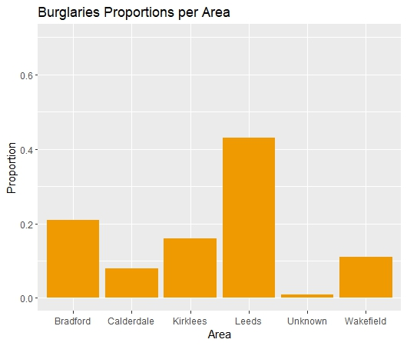
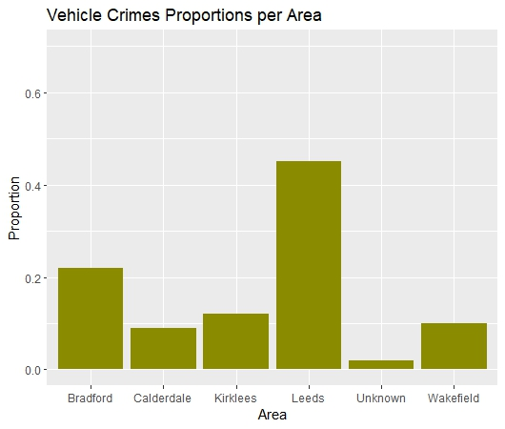
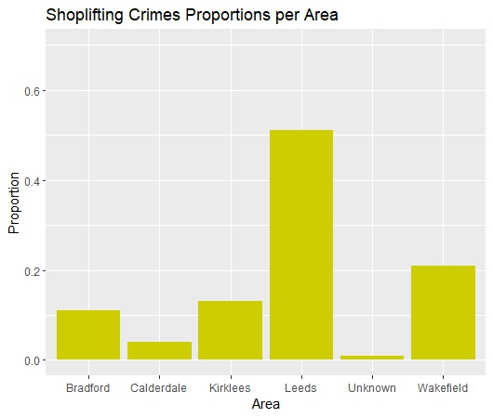
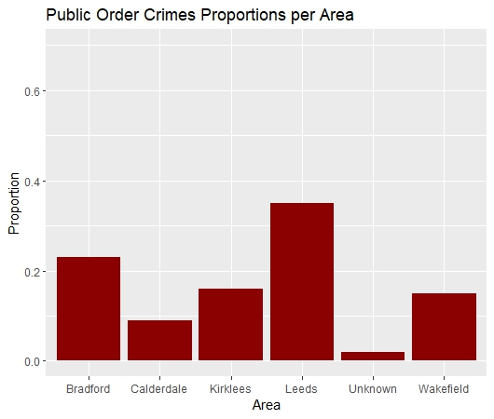
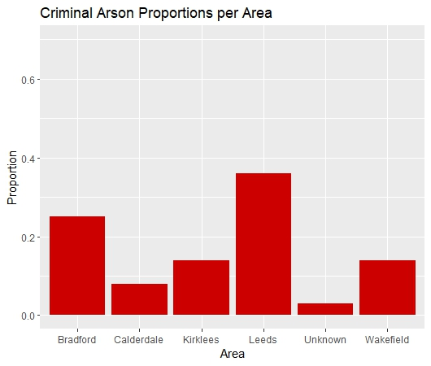
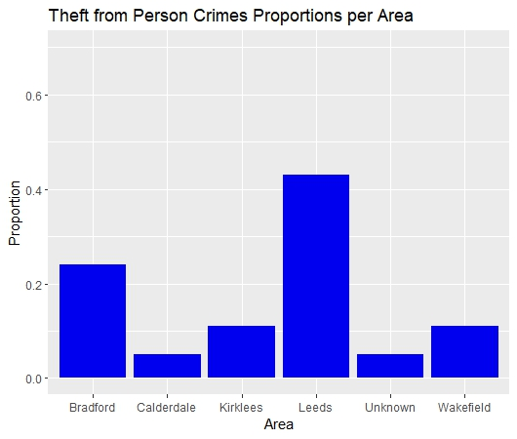
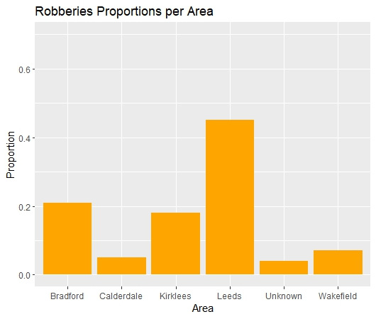
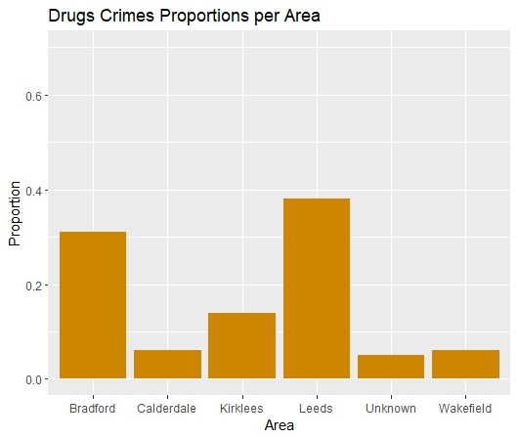
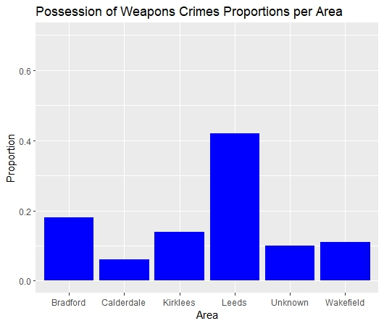
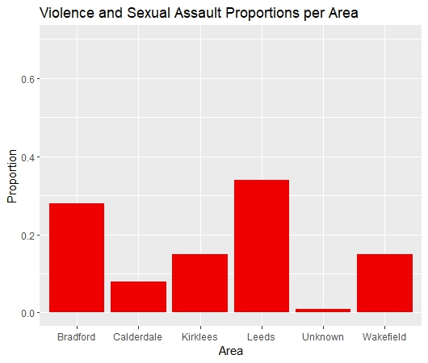

Slide 3
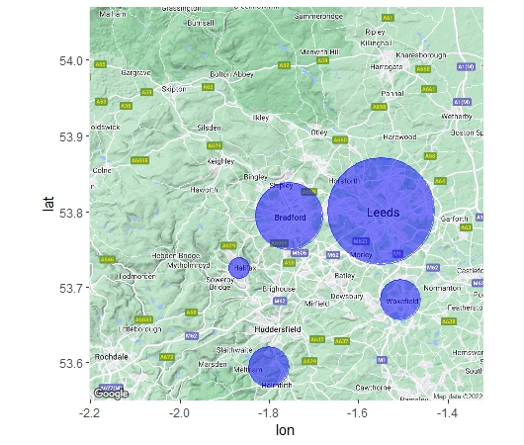
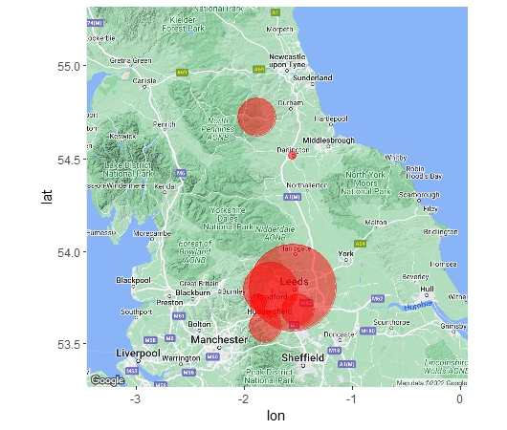

Slide 4
Insights from Slide 2:
The set of column charts compares the proportions of most of the crime types across six of the riskiest cities/towns in West Yorkshire.
Crime types include Bicycle thefts – Burglaries – Drugs – Public Order – Robberies – Shoplifting – Theft from Person – Vehicle Crimes – Violence and Sexual Assault – Possession of Weapons
Areas in West Yorkshire include Leeds – Bradford – Wakefield – Calderdale – Kirklees. I also kept the “Unknown” category as it accounts for a reasonable proportion of the crimes.
Leeds and Bradford dominate all crime types except for Shoplifting Crimes. Wakefield and Kirklees have the second and third highest proportion of Shoplifting crimes (respectively) followed by Bradford. Leeds still has the highest proportion of all.
Crimes involving the Possession of Weapons are the most likely to not have an undefined location. Also, a reasonable proportion of Drug Crimes, Robberies and Thefts from People have an undefined location.
Calderdale is the safest of the riskiest areas in West Yorkshire. There are a couple of other areas in the dataset, but I omitted them as they account for an extremely small proportion of the crimes.
Insights from Slide 3:
The maps show the areas of West Yorkshire and Durham. The size of the circles is proportional to the count of crimes in each area.
There are circles around 5 areas around West Yorkshire as well as Darlington and Durham (based on Longitude and Latitude).
The maps are a verification of the data found earlier and an effective visualization of the ratio of crime count in Leeds & Bradford to other cities.
The most crimes occur in Leeds followed by Bradford. Kirklees and Wakefield have very similar crime counts.
Durham also has a similar crime count to Wakefield and Kirklees.
Darlington accounts for a small portion of the crimes in Durham County.

